Slide 1
Digital Portfolio
STUDENT NAME: M. Humshirunisa
REGISTER NO AND NMID:24134111802522016 and asanm 41124134111802522016
DEPARTMENT: B.Sc.Computer Science
COLLEGE:Vivekananda college of arts and science for women and Annamalai university

Slide 2
PROJECT TITLE Student digital portfolio

Slide 3


AGENDA
Problem Statement
Project Overview
End Users
Tools and Technologies
Portfolio design and Layout
Features and Functionality
Results and Screenshots
Conclusion
Github Link
3/21/2024 Annual Review

Slide 4

PROBLEM STATEMENT
A problem statement is a brief description of an issue that needs to be addressed. It defines the gap between the current situation and the desired outcome, and sets the direction for finding solutions

Slide 5

PROJECT OVERVIEW
The Student Digital Portfolio project provides an online platform for students to showcase their academic achievements, skills, and projects in a structured and professional manner.

Slide 6

WHO ARE THE END USERS?
Students → who will create and manage their digital portfolios. Teachers / Mentors → who can review and assess student work. Recruiters / Employers → who can view portfolios to evaluate candidates for internships or jobs. Educational Institutions → who may use it to track student progress and showcase talent.

Slide 7

TOOLS AND TECHNIQUES
The Student Digital Portfolio will be developed using HTML, CSS, and JavaScript for front-end design and interactivity. Additional tools may include Bootstrap/Tailwind CSS for responsive layouts, GitHub for version control, and Canva/Figma for UI/UX design support.

Slide 8
POTFOLIO DESIGN AND LAYOUT
Clean, responsive design with sections for profile, about, skills, projects, and contact.
Grid-based layout for easy navigation and professional look across device
8

Slide 9
FEATURES AND FUNCTIONALITY
Student profile with photo, bio, and contact details. Sections for skills, projects, achievements, and resume.
Option to upload/download documents and certificates. Responsive design for access on mobile and desktop.

Slide 10
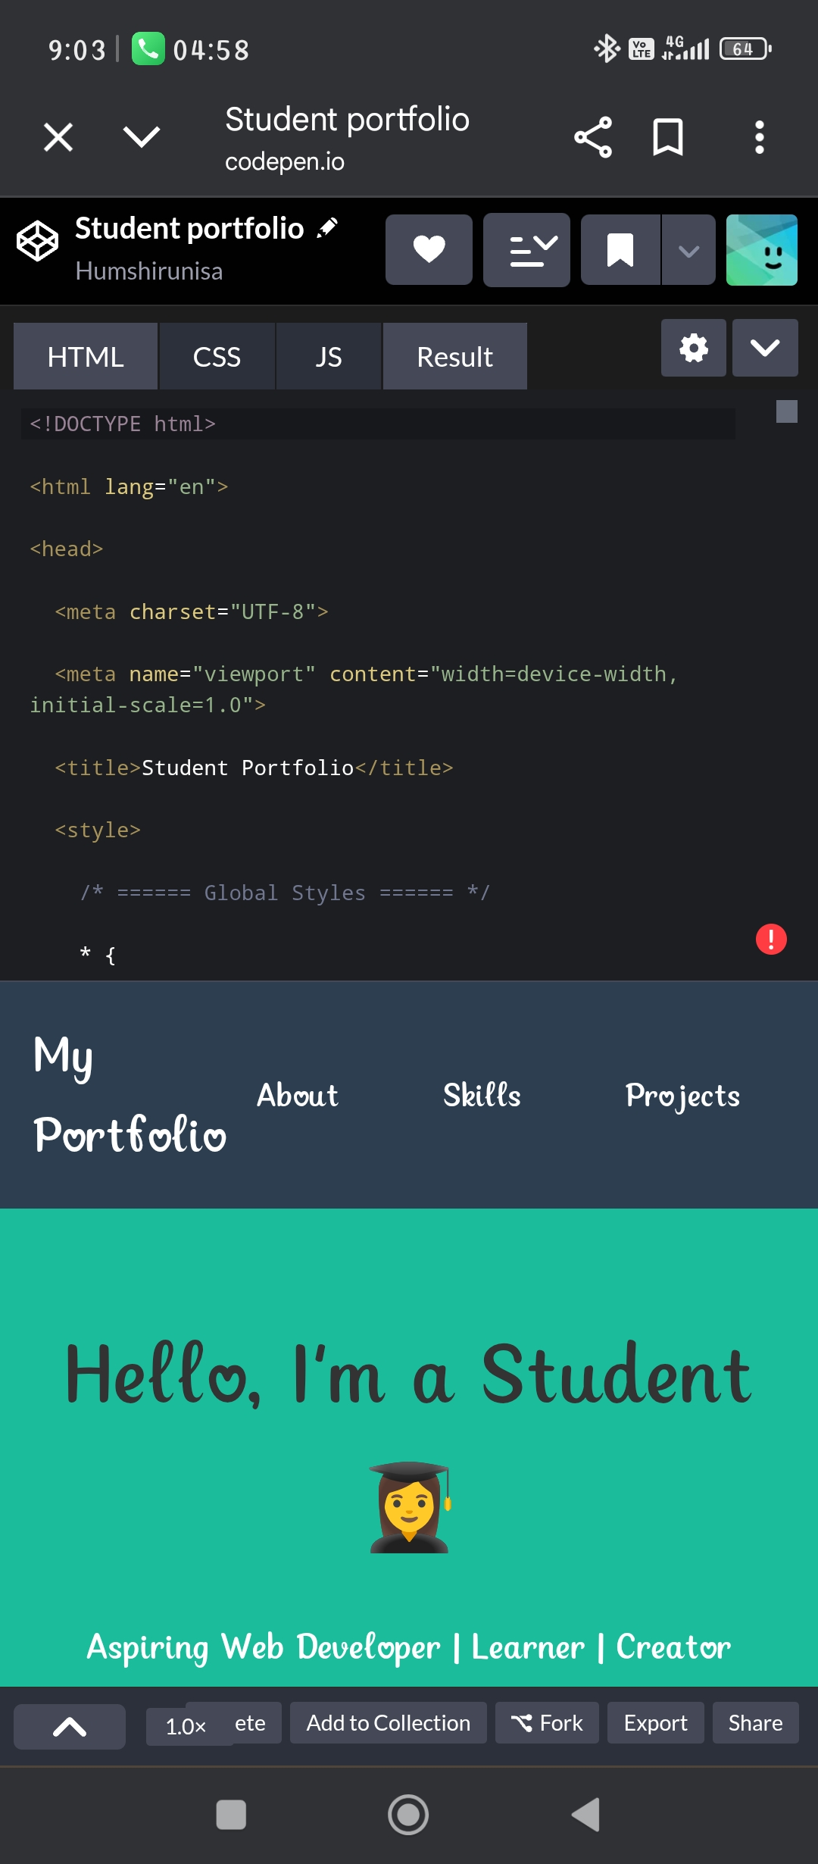

RESULTS AND SCREENSHOTS
The Student Digital Portfolio was successfully designed and implemented with sections for profile, skills, projects, and contact details.
Before(Before building the html, css, java script)
3/21/2024 Annual Review
10

Slide 11
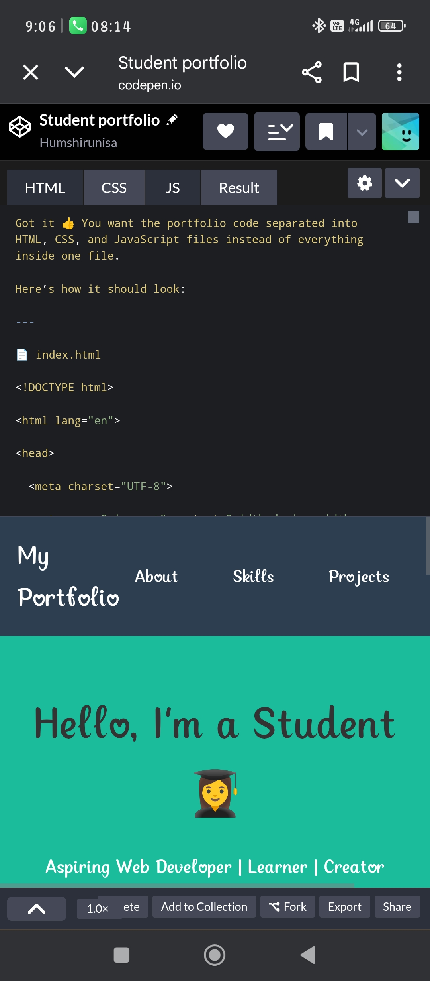
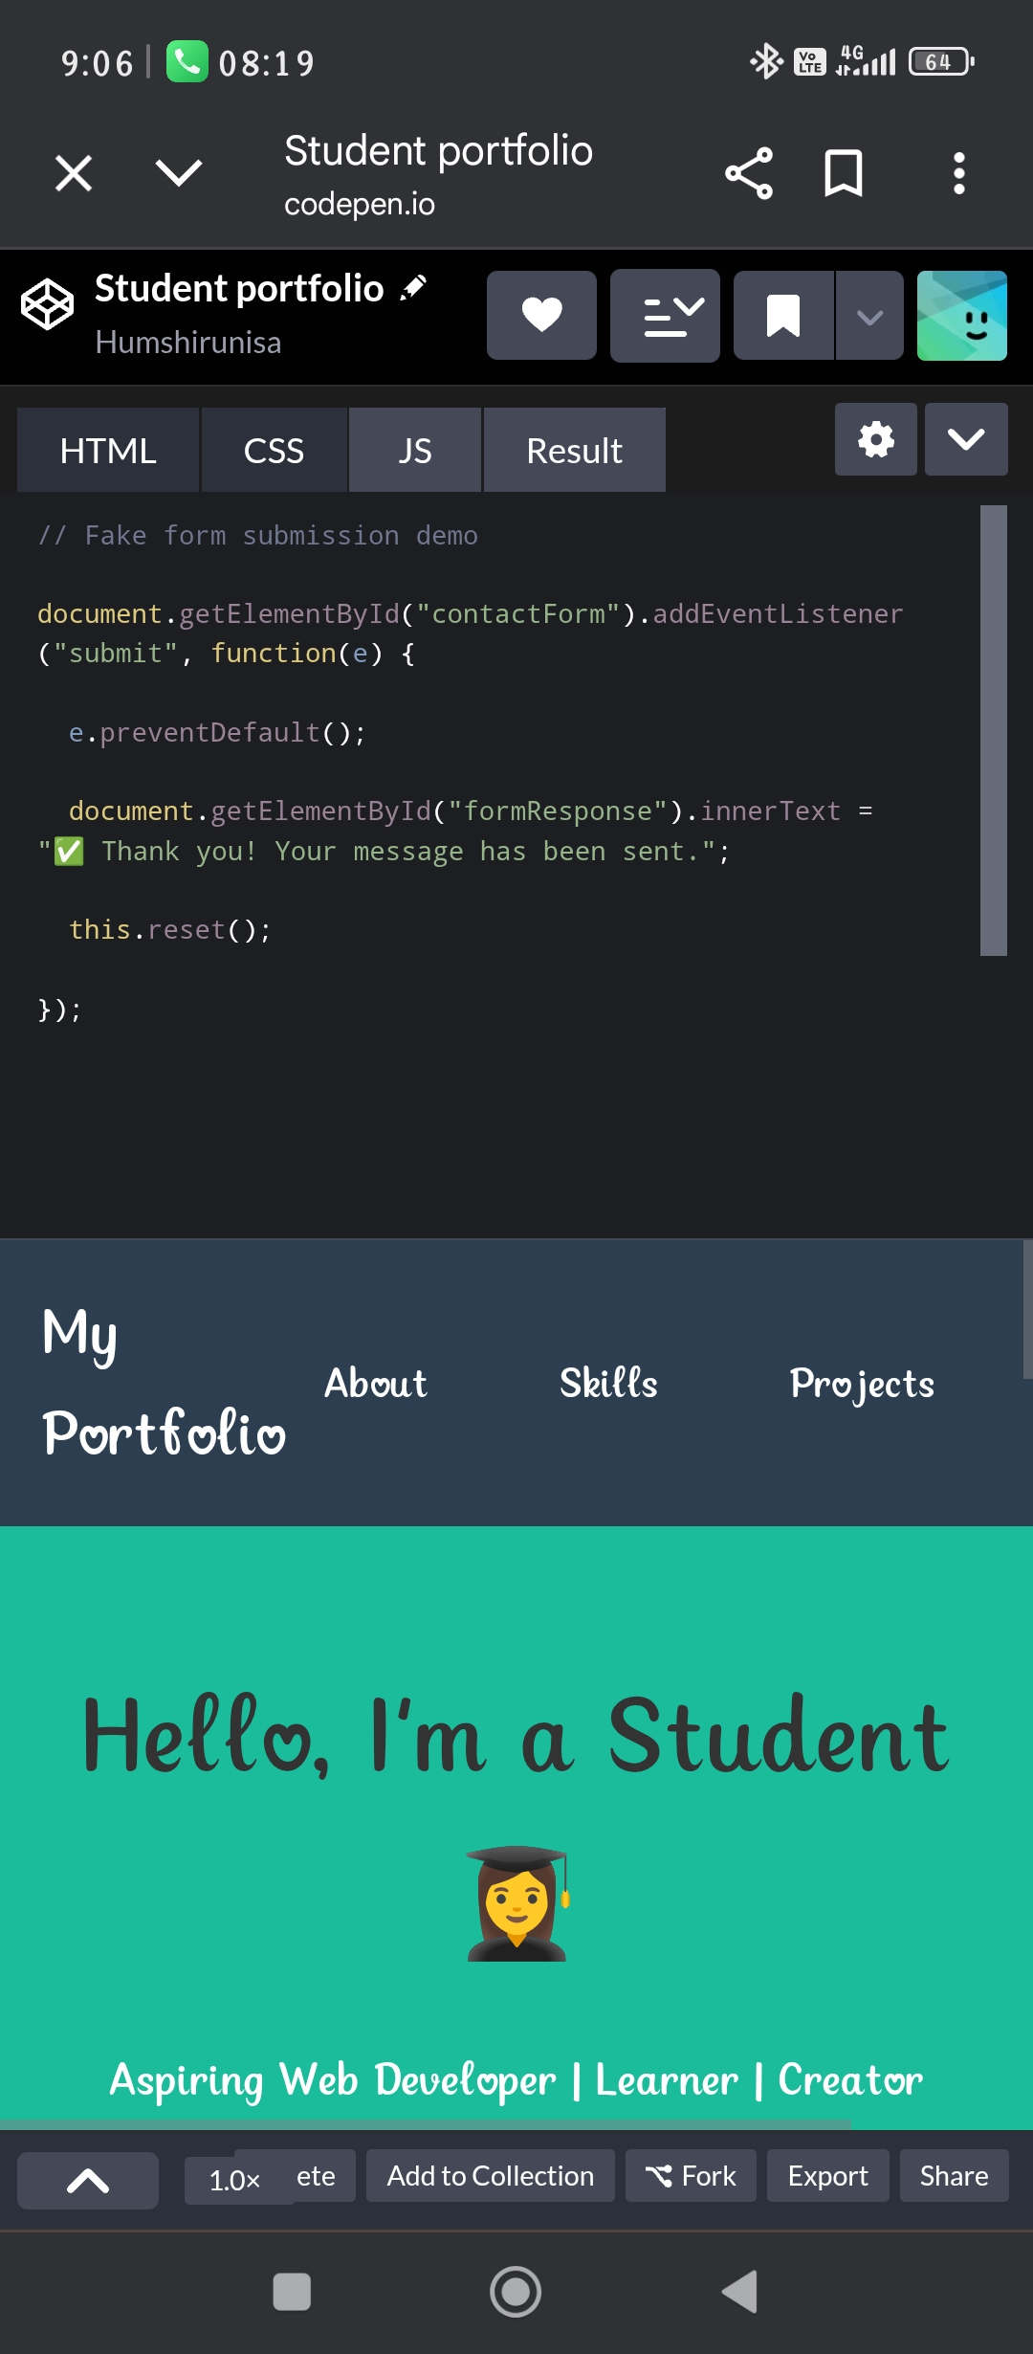
Results and screenshots
After(After implementing html, css, java script)

Slide 12
CONCLUSION
A student digital portfolio is an effective way to present academic achievements, skills, and creativity in an organized manner. It helps students reflect on their learning journey and showcase their strengths. By combining design and technology, the portfolio becomes a professional platform for career and educational opportunities. Overall, it serves as a bridge between learning experiences and future goals.
12

Slide 13
Conclusion
https://github.com/humshirunisacs24-boop/Humshirunisa-cs-ah.git

